Slide 1
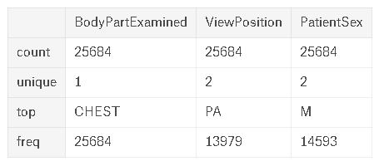
Images
25684 images found
Age/BodyPartExamined/ViewPosition/Sex
Radiostereoscopy : PA/AP

Slide 2
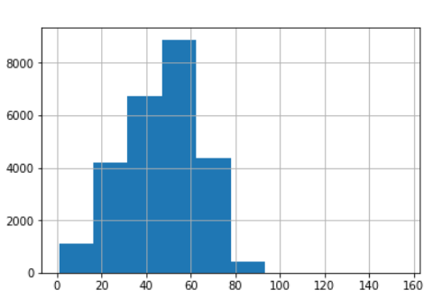
Images
age

Slide 3
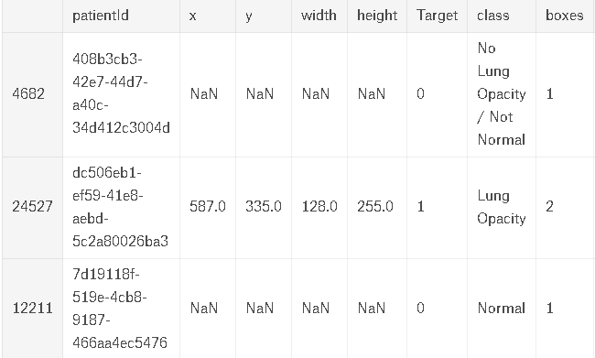
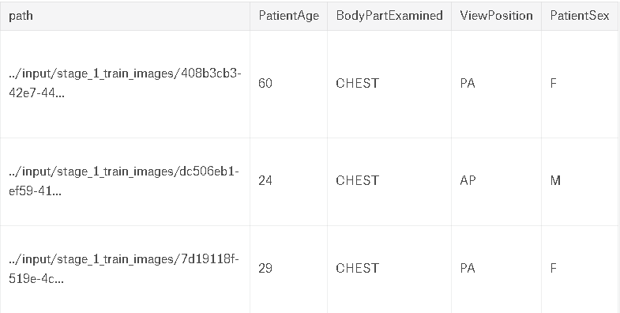
Images
28989 image bounding boxes

Slide 4
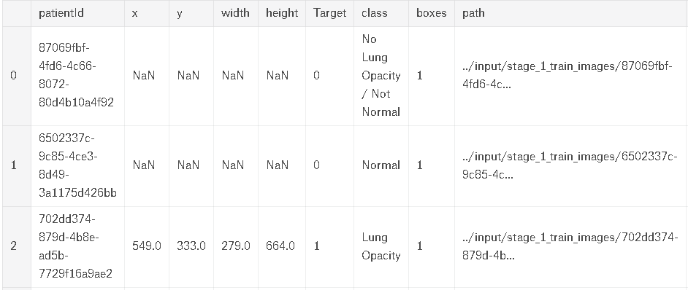
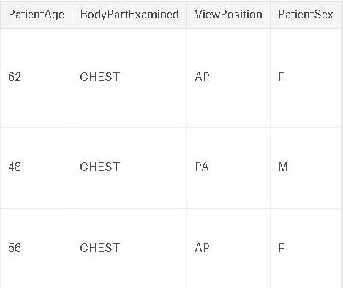
Create Sample Data Set
create a sample dataset covering different cases, and number of boxes
Groupby 1)Target 2)Class 3)number of boxes

Slide 5
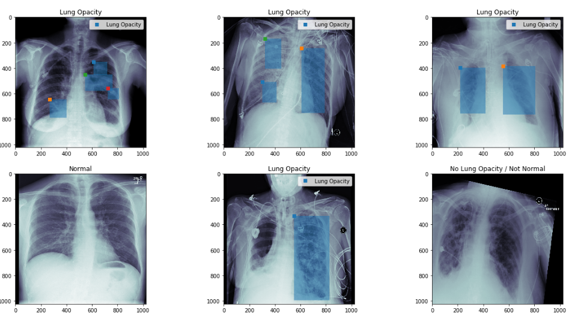
Show the position and bounding box

Slide 6
DICOM(Digital Imaging and Communications in Medicine)
Pydicom : Python package, makes it easy to read these complex files into natural pythonic structures for easy manipulation

Slide 7
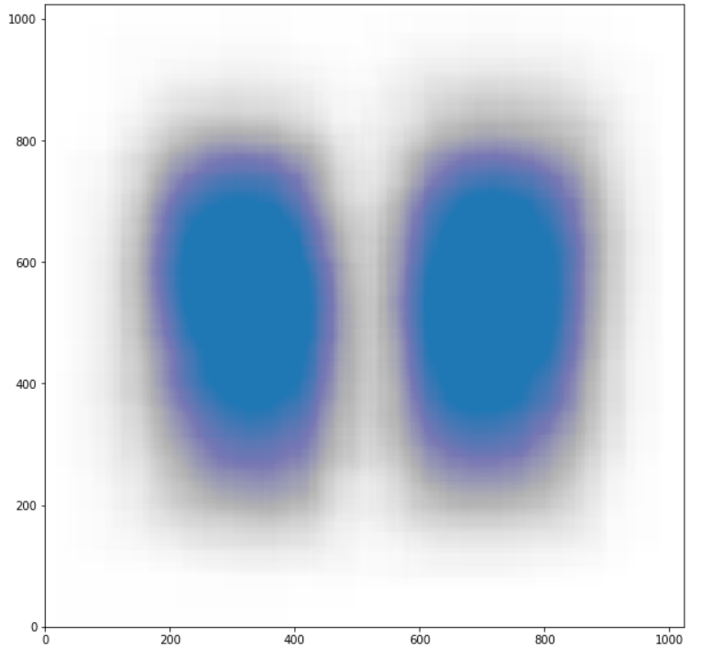
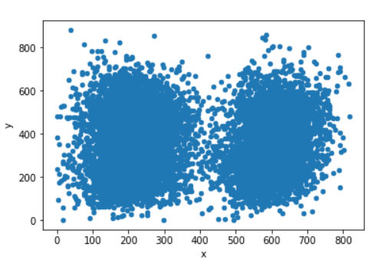
Bounding Box Distribution
Target==1

Slide 8
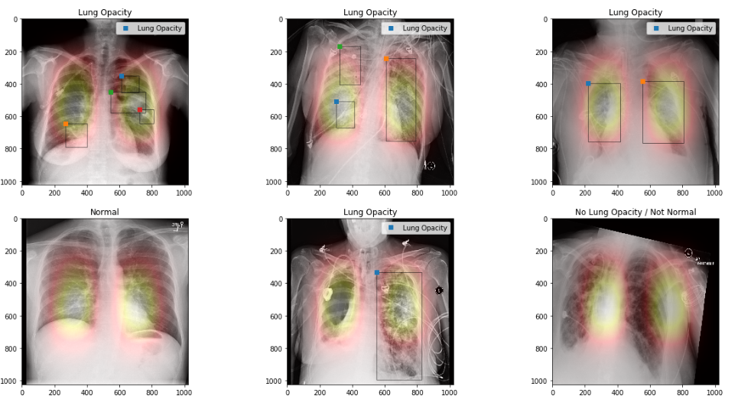
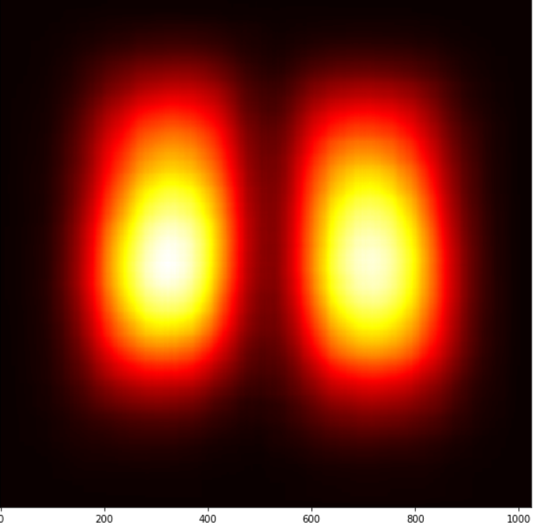
Show the boxes as segmentation
Target==1, number of sample==5000

